Slide 1



Better WebApp Development using OSGi
Raymond Augé
raymond.auge@liferay.com

Slide 2

Http Whiteboard
Resources
Servlets
Filters
Event Listeners
Error Pages
ServletContextHelper
DTOs

Slide 3
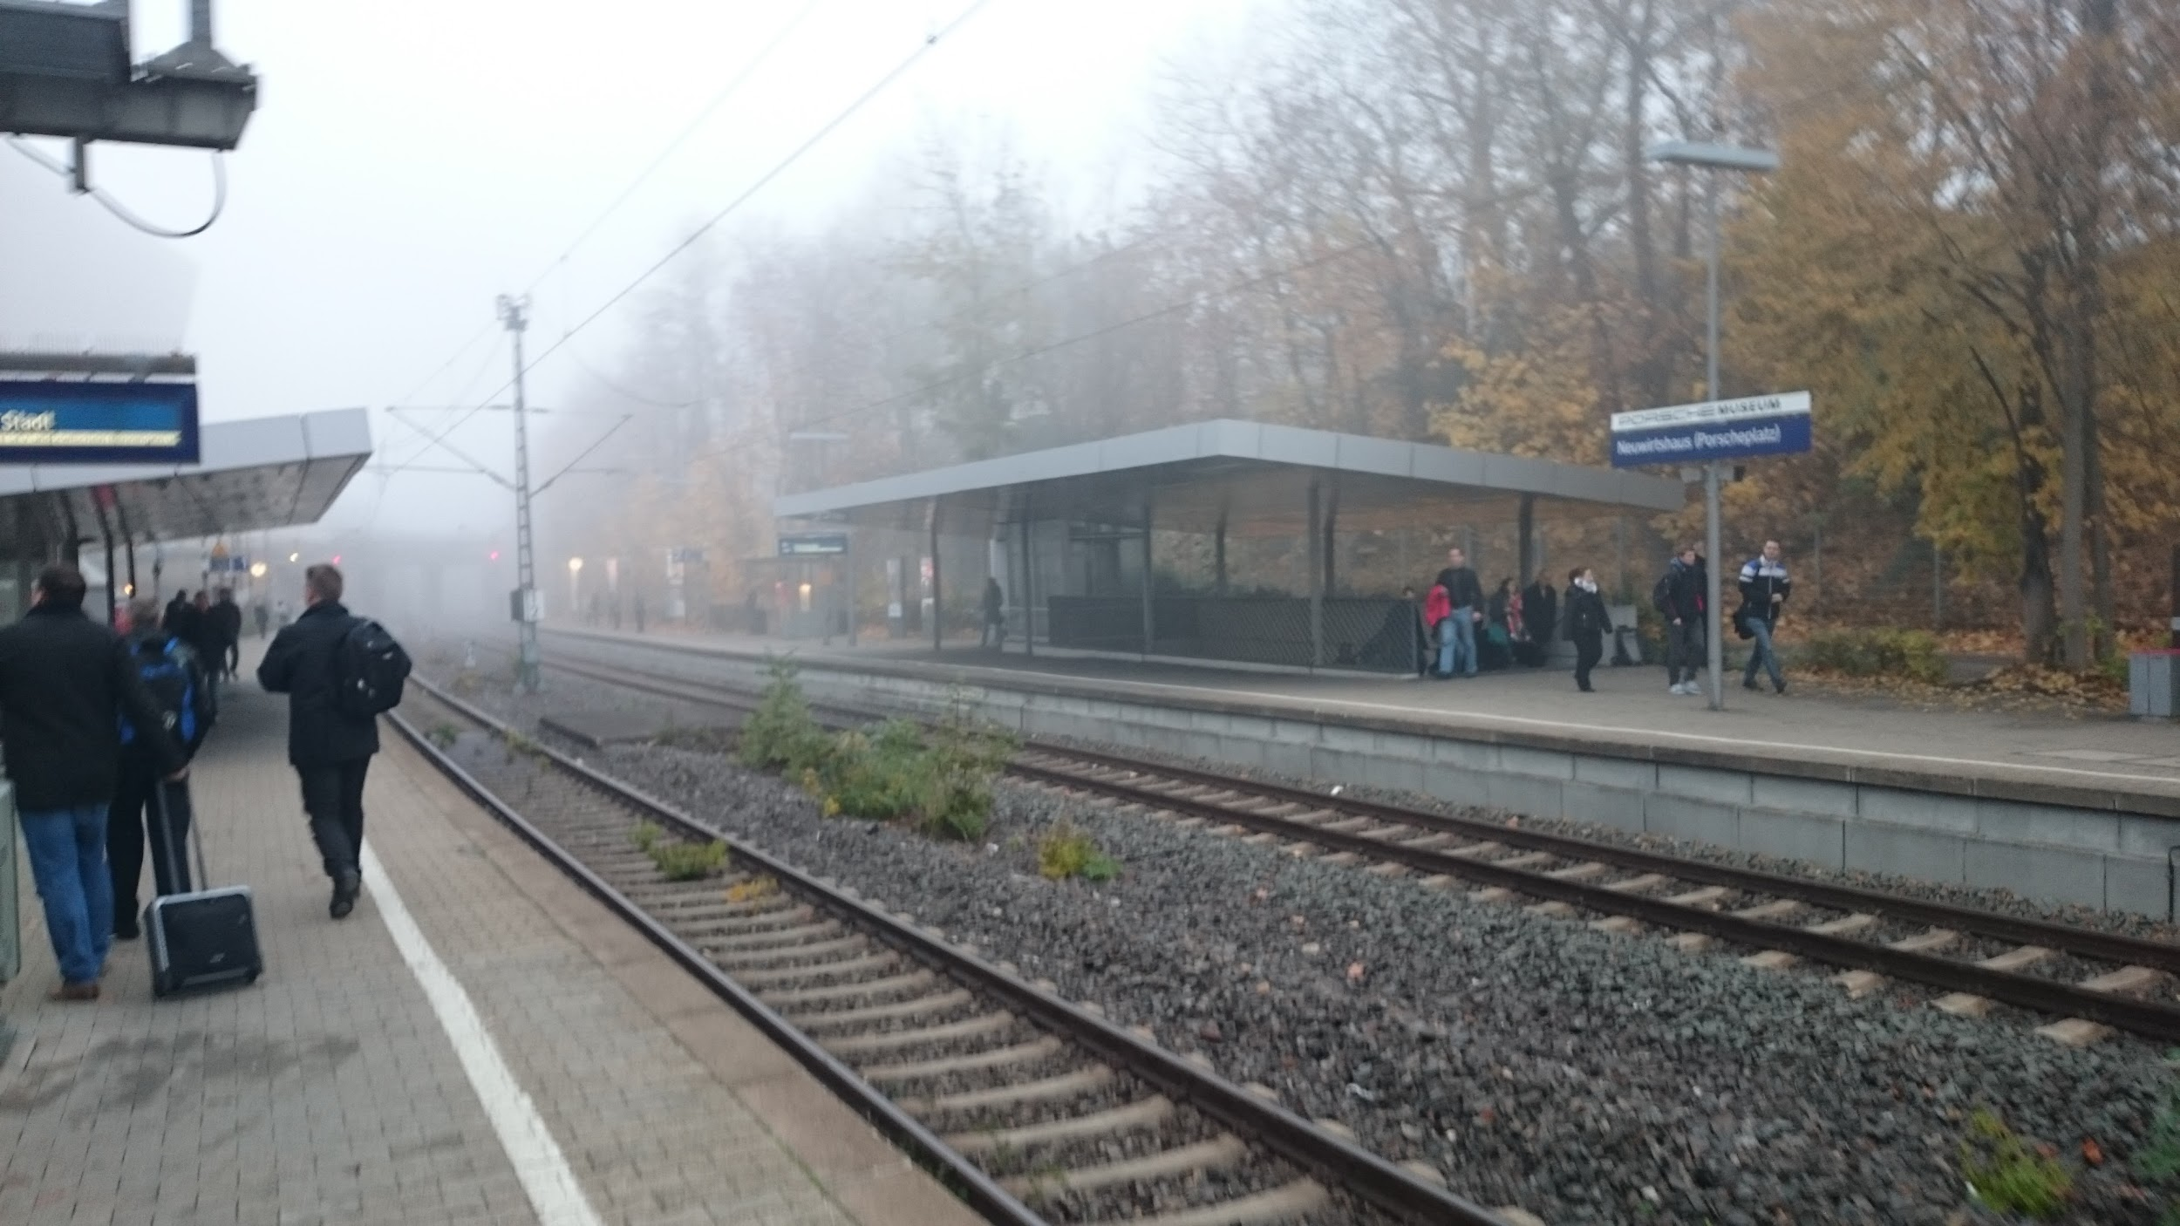
Added whiteboard style programming model
Long missing enhancements
Servlet 3.1 API

Slide 4

The code...

